Slide 1
Clocks, Counters, and Timers
HCM - 2021

Slide 2
Agenda
Clock sources
Basics of counters and timers
Clocks, counters, and timers in ARM Cortex-M chips
Labs

Slide 3
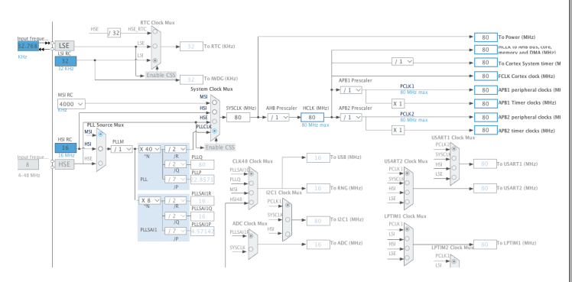
Clock Signals
Clock signals are required for a lot of stuff
CPU execution
Internal communications, e.g., peripheral bus
External communications, e.g., USB, USART
Analog-to-digital conversion
Tick generation for timers

Slide 4
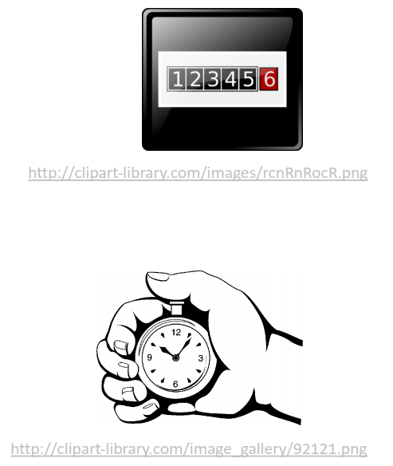
Counters and Timers
Counters and timers are ones of the most important components of MCUs
A counter keeps track of how many event ticks have occurred
A timer is a counter that counts deterministic clock cycles
Two terms are often used interchangeably

Slide 5
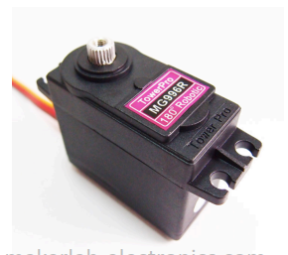
Typical Uses of Counters/Timers
Scheduling future events
One-shot events
Periodic events
Input capture
Measuring input pulse length
Output waveform generation
Output compare – flags or toggles output pin when the counter reaches a certain value
PPM = Pulse per Second
Pulse-width modulation (PWM) – generates
Analog output encoded as pulse length

Slide 6
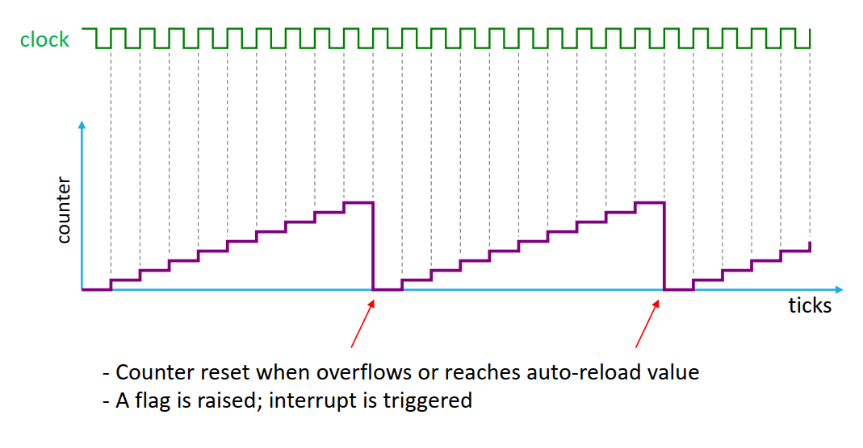
Basic Counter/Timer Operations

Slide 7
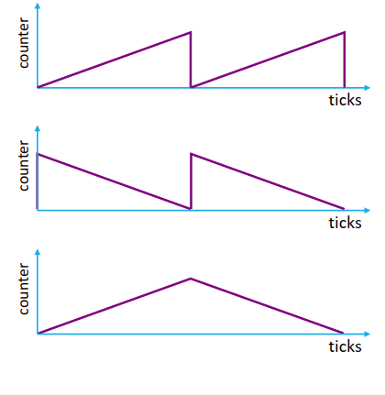
Counter Modes
Up-counting
Down-counting
Center aligned (up/down)

Slide 8
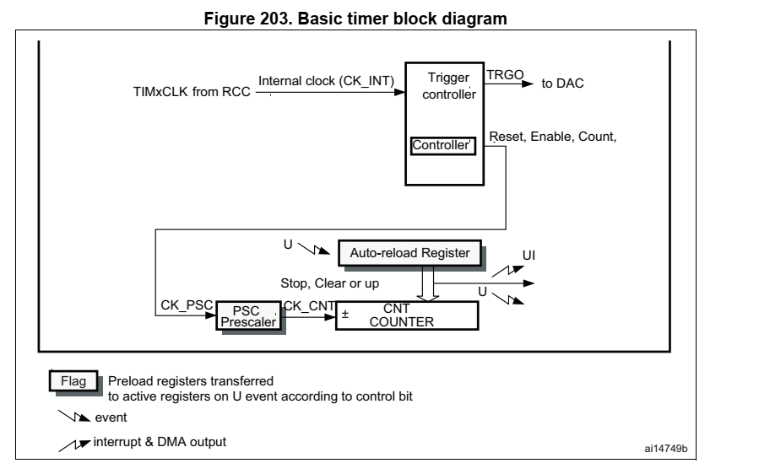
Basic timer block diagram

Slide 9
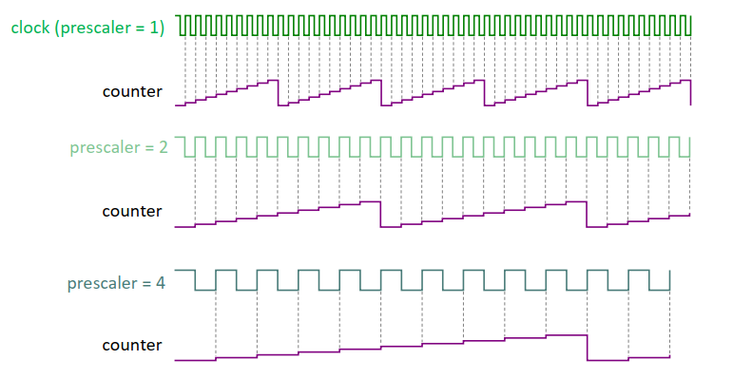
Prescaler
Divides clock frequency; increases timer period

Slide 10
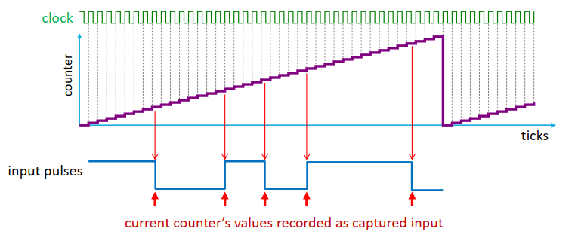
Input Capture
Measures input pulse lengths
Applications: decoding remote control signals, distance measurement

Slide 11
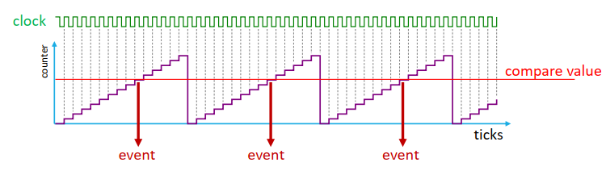
Output Compare
Generates an event when counter matches a certain value
Possible MCU’s behavior when receiving a compare event:
Sets a flag (Cleared by CPU)
Generates an interrupt
Sets, resets, or toggles output pin (real-time)

Slide 12
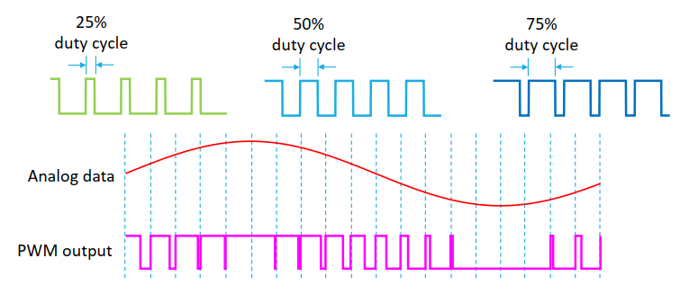
Pulse-Width Modulation (PWM)
PWM utilizes duty cycle control to simulate analog output
Applications: motor speed control, servo position control, LED brightness control

Slide 13
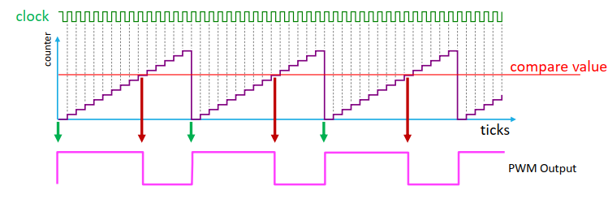
PWM Waveform Generation
Typical MCU behavior
Auto-reload event sets output pin high
Output-compare event sets output pin low
Output compare value determines PWM duty

Slide 14
STM32F4xx’s Timers
Basic timers: TIM6/TIM7
General-purpose timers: TIM2/TIM3 and TIM15/TIM16
Advanced timers: TIM1

Slide 15
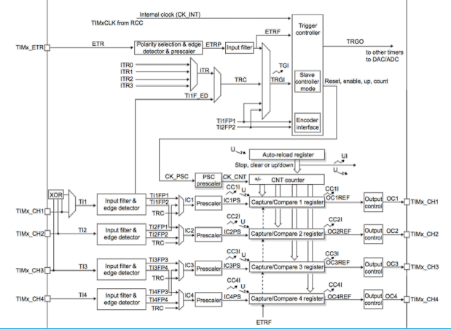
STM32F4xx’s General-Purpose Timers

Slide 16
Important Timer-Related Registers
TIMx->PSC (16 bits)
Prescaler for TIMx
PSC = 0 → no prescaler (prescaler = 1)
PSC = n → prescaler = n+1
TIMx->ARR (16/32 bits) – Counter Period
Auto-reload register for TIMx
Counter counts up to and including ARR
Therefore, reload occurs every ARR+1 clock ticks
TIMx->CCRy (32 bits)
Capture/compare register for TIMx, channel y

Slide 17


Calculating Timer Period/Frequency
Let
PSC = Prescaler (TIMx->PSC)
ARR = Auto-Reload Register (TIMx->ARR)
Then
or
Period_clock = APB clock

Slide 18
Example: Timer Period
What is the timer’s period in milliseconds with the following configuration?
Up-counting configuration
Input clock: 80 MHz
Prescaler (PSC): 999
Auto-reload register (ARR): 4999

Slide 19
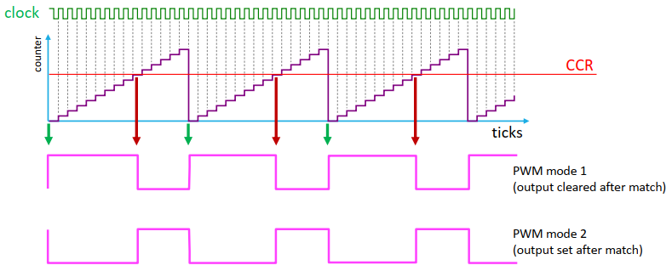
PWM Modes 1 vs 2

Slide 20
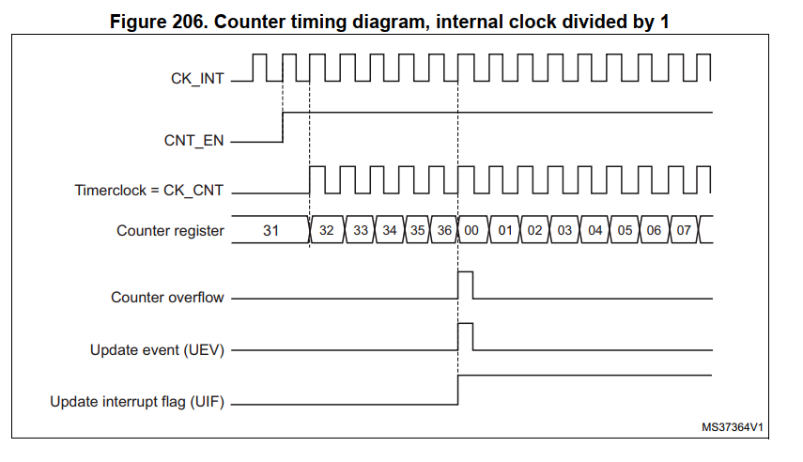
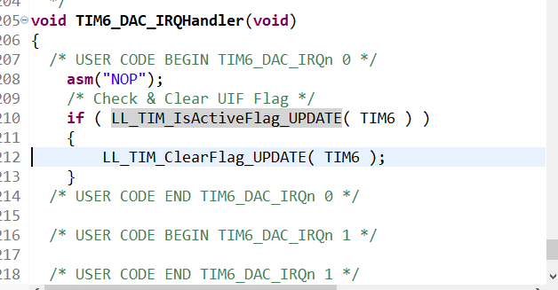
Check & Clear Update Flag

Slide 21
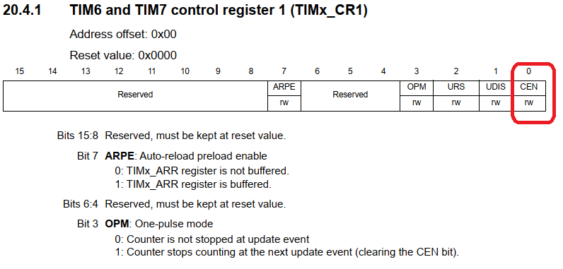

Slide 22
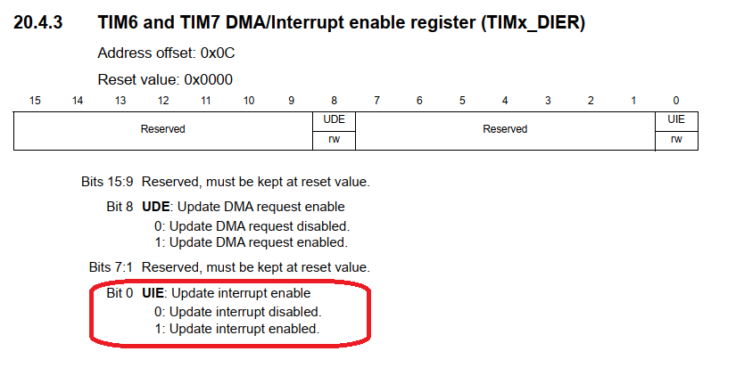

Slide 23
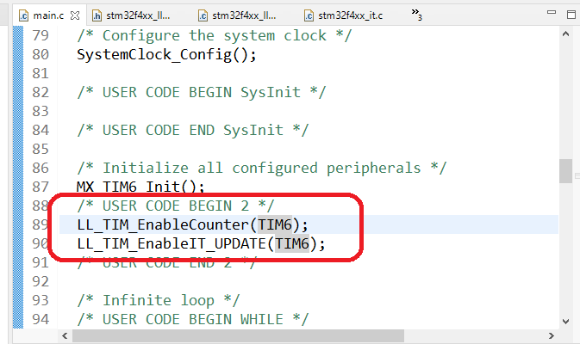

Slide 24
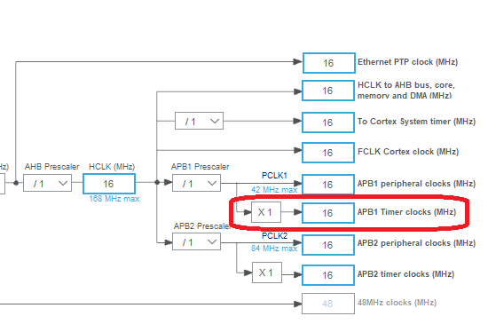
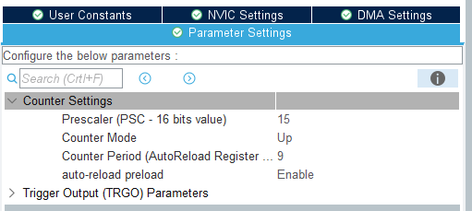
Timer Period Calculation
Timer Period = (AutoReload + 1) * Clock_Period
= (9 + 1) * (1/(16^6/15+1))
= 10 * 16/16^6
= 10 * 1^6
= 10 uS

Slide 25
Find Register Setting
Tạo ra event timer 100 us với APB1 clock = 36 MHz sử dụng TIM4
Analyzing step:
100 us ⬄ 0.1ms ⬄ Freq = 10 kHz
Clock Ratio = APB1_CLK / Tmr_Freq
= 36 MHz / 10 kHz
= 3.6 * 10^3
= 3600
Prescale = 36 & Auto-reload = 100
PSC Reg = 35 & ARR = 9

Slide 26
Find Register Setting
Tạo ra event timer 600 ms với APB1 clock = 36 MHz sử dụng TIM4
Analyzing step:
100 us ⬄ 0.1ms ⬄ Freq = 10 kHz
Clock Ratio = APB1_CLK / Tmr_Freq
= 36 MHz / 10 kHz
= 3.6 * 10^3
= 3600
Prescale = 36000 & Auto-reload = 500
PSC Reg = 35999 & ARR = 499

Slide 27
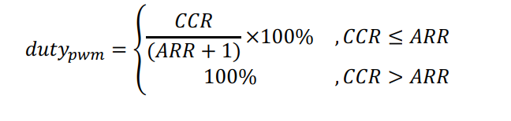
Calculating PWM Duty Cycle
Assume up-counting configuration and PWM mode 1
(output is clear when compare match)
Let
ARR = Auto-Reload Register (TIMx->ARR)
CCR = Capture/Compare Register (TIMx->CCRy)

Slide 28
Example: PWM Duty Cycle
1. TMR_CLK = 80 MHz / (79 + 1) = 1 MHz
2. TMR_TICK = 1 / 1MHz = 1 us
3. Overflow period = TMR_TICK * (ARR + 1)
= 1 us * 5000
= 5 ms
=> PWM Freq = 1 / Period = 1 / 5ms = 0.2 KHz
= 200 Hz
Duty % = 2000 / (4999 + 1)
= 2000 / 5000 * 100%
= 40 %
What is the PWM’s frequency and
duty cycle with the following configuration?
Up-counting configuration
Input clock: 80 MHz
Prescaler (PSC): 79
Auto-reload register (ARR): 4999
Capture/compare register (CRR): 2000
PWM mode 1

